Slide 1
Python
DAY 2

Slide 2
AGENDA
INTRODUCTION
Overview
What can you do with Python?
Installation & Setting up Path
Running Python

Slide 3
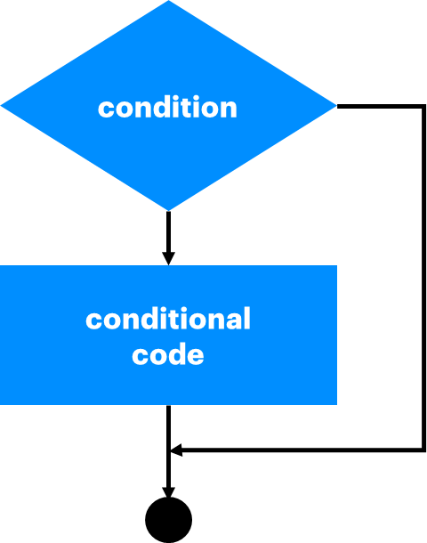
DECISION MAKING
Decision making is anticipation of conditions occurring while execution of the program and specifying actions taken according to the conditions.
Decision structures evaluate multiple expressions which produce TRUE or FALSE as outcome. You need to determine which action to take and which statements to execute if outcome is TRUE or FALSE otherwise.
If condition is true
If condition is false
This is the general form of a typical decision making structure found in most of the programming languages −

Slide 4
DECISION MAKING
Python programming language assumes any non-zero and non-null values as TRUE, and if it is either zero or null, then it is assumed as FALSE value.
Statement | Description
if statements | An if statement consists of a boolean expression followed by one or more statements.
if...else statements | An if statement can be followed by an optional else statement, which executes when the boolean expression is FALSE.
nested if statements | You can use one if or else if statement inside another if or else if statement(s).

Slide 5
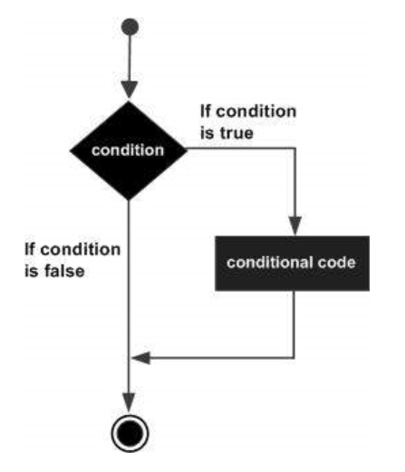
DECISION MAKING
I. PYTHON IF STATEMENT
It is similar to that of other languages. The if statement contains a logical expression using which data is compared and a decision is made based on the result of the comparison..
Syntax:
if expression:
statement(s)
Example
var1 = 100
if var1:
print("1 - Got a true expression value")
print(var1)
var2 = 0
if var2:
print("2 - Got a true expression value")
print var2
print "Good bye!"
Flow diagram

Slide 6
DECISION MAKING
Example
ma.a.d.serrano@PISI-7091S2N-LX MINGW64 ~/Desktop/python/scripts
$ python decision.py
1 - Got a true expression value
100
Good bye!

Slide 7
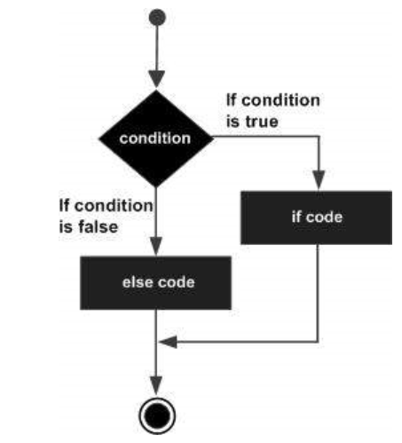
DECISION MAKING
II. PYTHON IF... ELSE STATEMENT
An else statement can be combined with an if statement. An else statement contains the block of code that executes if the conditional expression in the if statement resolves to 0 or a FALSE value.
The else statement is an optional statement and there could be at most only one else statement following if.
The elif statement allows you to check multiple expressions for TRUE and execute a block of code as soon as one of the conditions evaluates to TRUE.
Similar to the else, the elif statement is optional. However, unlike else, for which there can be at most one statement, there can be an arbitrary number of elif statements following an if.
Core Python does not provide switch or case statements as in other languages, but we can use if..elif...statements to simulate switch case as follows −
Flow diagram

Slide 8
DECISION MAKING
PYTHON ELIF STATEMENT
It is similar to that of other languages. The if statement contains a logical expression using which data is compared and a decision is made based on the result of the comparison..
Example
var = 100
if var == 200:
print =("1 - Got a true expression value")
print(var)
elif var == 150:
print("2 - Got a true expression value")
print(var)
elif var == 100:
print("3 - Got a true expression value")
print(var)
else:
print("4 - Got a false expression value")
print(var)
print("Good bye!")
When this code ←is executed, it produces the following result
ma.a.d.serrano@PISI-7091S2N-LX MINGW64 ~/Desktop/python/scripts
$ python elif.py
3 - Got a true expression value
100
Good bye!

Slide 9
DECISION MAKING
III. NESTED IF STATEMENTS
There may be a situation when you want to check for another condition after a condition resolves to true. In such a situation, you can use the nested if construct.
In a nested if construct, you can have an if...elif...else construct inside another if...elif...else construct.
Example -
var = 100
if var < 200:
print("Expression value is less than 200")
if var == 150:
print("Which is 150")
elif var == 100:
print("Which is 100")
elif var < 50:
print("Expression value is less than 50")
else:
print("Could not find true expression")
print("Good bye!“)

Slide 10
DECISION MAKING
When the code is executed, it produces following result −
ma.a.d.serrano@PISI-7091S2N-LX MINGW64 ~/Desktop/python/scripts
$ python nested.py
Expression value is less than 200
Which is 100
Good bye!

Slide 11
DECISION MAKING
SINGLE STATEMENT SUITES
If the suite of an if clause consists only of a single line, it may go on the same line as the header statement.
Here is an example of a one-line if clause −
When the code is executed, it produces the following result −
var = 100
if ( var == 100 ) : print("Value of expression is 100")
print("Good bye!")
ma.a.d.serrano@PISI-7091S2N-LX MINGW64 ~/Desktop/python/scripts
$ python suite.py
Value of expression is 100
Good bye!

Slide 12
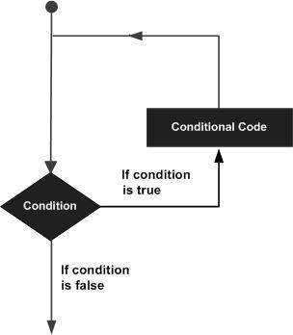
LOOPS
In general, statements are executed sequentially: The first statement in a function is executed first, followed by the second, and so on. There may be a situation when you need to execute a block of code several number of times.
Programming languages provide various control structures that allow for more complicated execution paths.
A loop statement allows us to execute a statement or group of statements multiple times. The following diagram illustrates a loop statement −

Slide 13
LOOPS
Python programming language provides following types of loops to handle looping requirements.
while loop
Repeats a statement or group of statements while a given condition is TRUE. It tests the condition before executing the loop body.
for loop
Executes a sequence of statements multiple times and abbreviates the code that manages the loop variable.
nested loops
You can use one or more loop inside any another while, for or do..while loop.

Slide 14
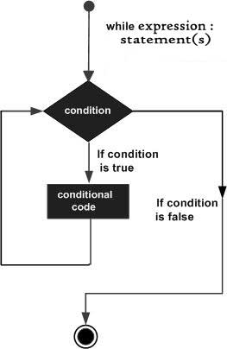
LOOPS - WHILE
A while loop statement in Python programming language repeatedly executes a target statement as long as a given condition is true.
The syntax of a while loop in Python programming language is
while expression:
statement(s)
Here, statement(s) may be a single statement or a block of statements. The condition may be any expression, and true is any non-zero value. The loop iterates while the condition is true.
When the condition becomes false, program control passes to the line immediately following the loop.
Notes:
In Python, all the statements indented by the same number of character spaces after a programming construct are considered to be part of a single block of code. Python uses indentation as its method of grouping statements.

Slide 15
LOOPS - WHILE
Example
count = 0
while (count < 9):
print('The count is:', count)
count = count + 1
print("Good bye!")
When the code is executed, it produces the following result
ma.a.d.serrano@PISI-7091S2N-LX MINGW64 ~/Desktop/python/scripts/loops
$ python while.py
The count is: 0
The count is: 1
The count is: 2
The count is: 3
The count is: 4
The count is: 5
The count is: 6
The count is: 7
The count is: 8
Good bye!
The block here, consisting of the print and increment statements, is executed repeatedly until count is no longer less than 9.
With each iteration, the current value of the index count is displayed and then increased by 1.

Slide 16
LOOPS - WHILE
THE INFINITE LOOP
A loop becomes infinite loop if a condition never becomes FALSE. You must use caution when using while loops because of the possibility that this condition never resolves to a FALSE value. This results in a loop that never ends. Such a loop is called an infinite loop.
An infinite loop might be useful in client/server programming where the server needs to run continuously so that client programs can communicate with it as and when required.
Example:
Output
var = 1
while var == 1 : # This constructs an infinite loop
num = input("Enter a number :")
print("You entered: ", num)
print("Good bye!")
ma.a.d.serrano@PISI-7091S2N-LX MINGW64 ~/Desktop/python/scripts/loops
$ python infinite.py
Enter a number :4
You entered: 4
Enter a number :4
You entered: 4
Notes:
Above example goes in an infinite loop and you need to use CTRL+C to exit the program.

Slide 17
LOOPS - WHILE
USING ELSE STATEMENT WITH LOOPS
Python supports to have an else statement associated with a loop statement. If the else statement is used with a for loop, the else statement is executed when the loop has exhausted iterating the list.
If the else statement is used with a while loop, the else statement is executed when the condition becomes false.
The following example illustrates the combination of an else statement with a while statement that prints a number as long as it is less than 5, otherwise else statement gets executed.
Output
ma.a.d.serrano@PISI-7091S2N-LX MINGW64 ~/Desktop/python/scripts/loops
$ python else.py
0 is less than 5
1 is less than 5
2 is less than 5
3 is less than 5
4 is less than 5
5 is not less than 5
count = 0
while count < 5:
print(count, " is less than 5")
count = count + 1
else:
print(count, " is not less than 5")

Slide 18
LOOPS - WHILE
SINGLE STATEMENT SUITES
Similar to the if statement syntax, if your while clause consists only of a single statement, it may be placed on the same line as the while header.
Here is the syntax and example of a one-line while clause
Output
flag = 1
while (flag): print('Given flag is really true!')
print("Good bye!")
ma.a.d.serrano@PISI-7091S2N-LX MINGW64 ~/Desktop/python/scripts/loops
$ python single.py
Given flag is really true!
Given flag is really true!
Given flag is really true!
Given flag is really true!
Given flag is really true!
Given flag is really true!
Given flag is really true!
Given flag is really true!
The above example goes into infinite loop and you need to press CTRL+C keys to exit.

Slide 19
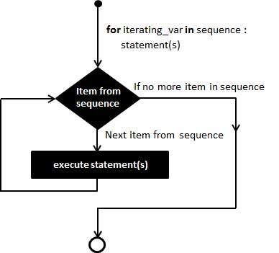
LOOPS - FOR
FOR LOOP
It has the ability to iterate over the items of any sequence, such as a list or a string.
Example
for iterating_var in sequence:
statements(s)
If a sequence contains an expression list, it is evaluated first. Then, the first item in the sequence is assigned to the iterating variable iterating_var.
Next, the statements block is executed. Each item in the list is assigned to iterating_var, and the statement(s) block is executed until the entire sequence is exhausted.

Slide 20
LOOPS - WHILE
Example
for letter in 'Python': # First Example
print('Current Letter :', letter)
fruits = ['banana', 'apple', 'mango']
for fruit in fruits: # Second Example
print('Current fruit :', fruit)
print("Good bye!")
When the code is executed, it produces the following result
ma.a.d.serrano@PISI-7091S2N-LX MINGW64 ~/Desktop/python/scripts/loops
$ python for.py
Current Letter : P
Current Letter : y
Current Letter : t
Current Letter : h
Current Letter : o
Current Letter : n
Current fruit : banana
Current fruit : apple
Current fruit : mango
Good bye!

Slide 21
LOOPS - FOR
ITERATING BY SEQUENCE INDEX
An alternative way of iterating through each item is by index offset into the sequence itself. Following is a simple example
fruits = ['banana', 'apple', 'mango']
for index in range(len(fruits)):
print('Current fruit :', fruits[index])
print("Good bye!")
Output
ma.a.d.serrano@PISI-7091S2N-LX MINGW64 ~/Desktop/python/scripts/loops
$ python sequence.py
Current fruit : banana
Current fruit : apple
Current fruit : mango
Good bye!
Here, we took the assistance of the len() built-in function, which provides the total number of elements in the tuple as well as the range() built-in function to give us the actual sequence to iterate over.

Slide 22
LOOPS - FOR
USING ELSE STATEMENTS WITH LOOP
Python supports to have an else statement associated with a loop statement
If the else statement is used with a for loop, the else statement is executed when the loop has exhausted iterating the list.
If the else statement is used with a while loop, the else statement is executed when the condition becomes false.
The following example illustrates the combination of an else statement with a for statement that searches for prime numbers from 10 through 20.
for num in range(10,20): #to iterate between 10 to 20
for i in range(2,num): #to iterate on the factors of the number
if num%i == 0: #to determine the first factor
j=num/i #to calculate the second factor
print('%d equals %d * %d' % (num,i,j))
break #to move to the next number, the #first FOR
else: # else part of the loop
print(num, 'is a prime number')

Slide 23
LOOPS - FOR
ma.a.d.serrano@PISI-7091S2N-LX MINGW64 ~/Desktop/python/scripts/loops
$ python elsefor.py
10 equals 2 * 5
11 is a prime number
11 is a prime number
11 is a prime number
11 is a prime number
11 is a prime number
11 is a prime number
11 is a prime number
11 is a prime number
11 is a prime number
12 equals 2 * 6
13 is a prime number
13 is a prime number
13 is a prime number
13 is a prime number
13 is a prime number
13 is a prime number
13 is a prime number
13 is a prime number
13 is a prime number
13 is a prime number
13 is a prime number
14 equals 2 * 7
15 is a prime number
15 equals 3 * 5
16 equals 2 * 8
17 is a prime number
17 is a prime number
17 is a prime number
17 is a prime number
17 is a prime number
17 is a prime number
17 is a prime number
17 is a prime number
17 is a prime number
17 is a prime number
17 is a prime number
17 is a prime number
17 is a prime number
17 is a prime number
17 is a prime number
18 equals 2 * 9
19 is a prime number
19 is a prime number
19 is a prime number
19 is a prime number
19 is a prime number
19 is a prime number
19 is a prime number
19 is a prime number
19 is a prime number
19 is a prime number
19 is a prime number
19 is a prime number
19 is a prime number
19 is a prime number
19 is a prime number
19 is a prime number
19 is a prime number

Slide 24

LOOPS - NESTED
NESTED LOOPS
Python programming language allows to use one loop inside another loop. Following section shows few examples to illustrate the concept.
for iterating_var in sequence:
for iterating_var in sequence:
statements(s)
statements(s)
A final note on loop nesting is that you can put any type of loop inside of any other type of loop. For example a for loop can be inside a while loop or vice versa.
The syntax for a nested while loop statement in Python programming language is as follows −
while expression:
while expression:
statement(s)
statement(s)

Slide 25
LOOPS - NESTED
EXAMPLE
The following program uses a nested for loop to find the prime numbers from 2 to 100
OUTPUT
ma.a.d.serrano@PISI-7091S2N-LX MINGW64 ~/Desktop/python/scripts/loops
$ python nested.py
2 is prime
3 is prime
5 is prime
7 is prime
11 is prime
13 is prime
17 is prime
19 is prime
23 is prime
29 is prime
31 is prime
37 is prime
41 is prime
43 is prime
47 is prime
53 is prime
59 is prime
61 is prime
67 is prime
71 is prime
73 is prime
79 is prime
83 is prime
89 is prime
97 is prime
Good bye!
i = 2
while(i < 100):
j = 2
while(j <= (i/j)):
if not(i%j): break
j = j + 1
if (j > i/j) : print(i, " is prime")
i = i + 1
print("Good bye!")

Slide 26
LOOPS
LOOP CONTROL STATEMENTS
Loop control statements change execution from its normal sequence. When execution leaves a scope, all automatic objects that were created in that scope are destroyed. Python supports the following control statements.
break statement
Terminates the loop statement and transfers execution to the statement immediately following the loop.
continue statement
Causes the loop to skip the remainder of its body and immediately retest its condition prior to reiterating.
pass statement
The pass statement in Python is used when a statement is required syntactically but you do not want any command or code to execute.

Slide 27
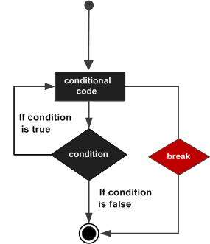
LOOPS - break
Example of break statement
var = 10
while var > 0:
print('Current variable value :', var)
var = var -1
if var == 5:
break
print("Good bye!")
Output
ma.a.d.serrano@PISI-7091S2N-LX MINGW64 ~/Desktop/python/scripts/loops
$ python break.py
Current variable value : 10
Current variable value : 9
Current variable value : 8
Current variable value : 7
Current variable value : 6
Good bye!
Notes:
It terminates the current loop and resumes execution at the next statement, just like the traditional break statement in C.
The most common use for break is when some external condition is triggered requiring a hasty exit from a loop. The break statement can be used in both while and for loops.
If you are using nested loops, the break statement stops the execution of the innermost loop and start executing the next line of code after the block.

Slide 28
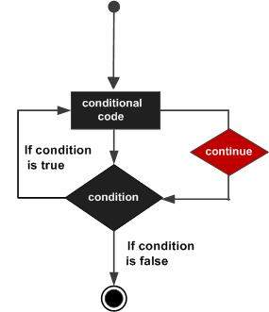
LOOPS - continue
Example of continue statement
var = 8
while var > 0:
var = var -1
if var == 5:
continue
print('Current variable value :', var)
print("Good bye!")
Output
ma.a.d.serrano@PISI-7091S2N-LX MINGW64 ~/Desktop/python/scripts/loops
$ python break.py
Current variable value : 7
Current variable value : 6
Current variable value : 4
Current variable value : 3
Current variable value : 2
Current variable value : 1
Current variable value : 0
Good bye!
Notes:
It returns the control to the beginning of the while loop.. The continue statement rejects all the remaining statements in the current iteration of the loop and moves the control back to the top of the loop.
The continue statement can be used in both while and for loops.

Slide 29
LOOPS - pass
Example of pass statement
for letter in 'Python':
if letter == 'h':
pass
print('This is pass block')
print('Current Letter :', letter)
print("Good bye!")
Output
ma.a.d.serrano@PISI-7091S2N-LX MINGW64 ~/Desktop/python/scripts/loops
$ python pass.py
Current Letter : P
Current Letter : y
Current Letter : t
This is pass block
Current Letter : h
Current Letter : o
Current Letter : n
Good bye!
Notes:
It is used when a statement is required syntactically but you do not want any command or code to execute.
The pass statement is a null operation; nothing happens when it executes. The pass is also useful in places where your code will eventually go, but has not been written yet (e.g., in stubs for example) −

